Slide 1
Real State Pricing
Data Acquisition & Exploratory Data Analysis(EDA)
Nexthikes Project
By:Garima Choraria

Slide 2
Introduction
Acquisition of dataset containing information about Real Estate Pricing which is titled as “Housing Data”. The Purpose of this analysis is to learn how to perform Exploratory Data Analysis(EDA) and Feature Engineering.
EDA helps us to give us insights of data and while performing EDA its necessary to ensure that data doesn’t have any null or duplicate values.
Feature Engineering helps to generate new feature by which we can get more detail information about relation that present in dataset.
The dataset comprises 1460rows and 81 columns, including features like Sale Price, Sale condition, sold year, street, alley, and etc.

Slide 3
Objectives
Dataset Composition: The data is divided into two parts numerical and categorial.
There were four column is dataset which having a missing values.
There is no duplicate data in the dataset.
Handling missing values by using technique of replacing value through mean and mode.
Numerical columns were replaced by mean and Categorical columns were replaced by mode.
After complete all above mention steps achieved a clean data with no missing values and no duplicates.

Slide 4
Explanatory Data Analysis
EDA is divided into two parts
Univariate Analysis:- One of is simplest form of analysing data. As name suggest Uni means “one” so in this only one variable can be analyze.
Multivariate Analysis:- Multivariate analysis involves analysing the relationship between multiple variables and helps to understand how they influence and related to each other.

Slide 5
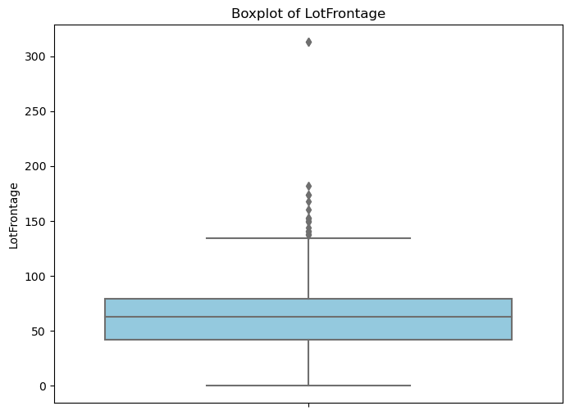
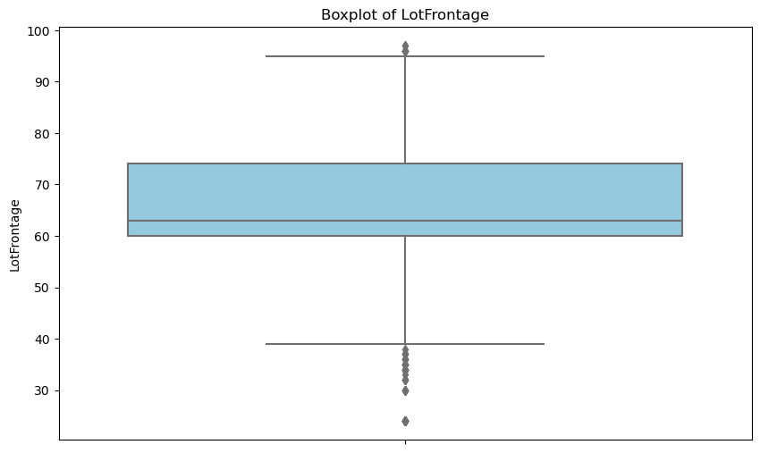
Detecting & Treating Outliers
Outliers were detected in all the numerical columns which were treated by using IQR technique
Example of one numerical column before and after treating outliers

Slide 6
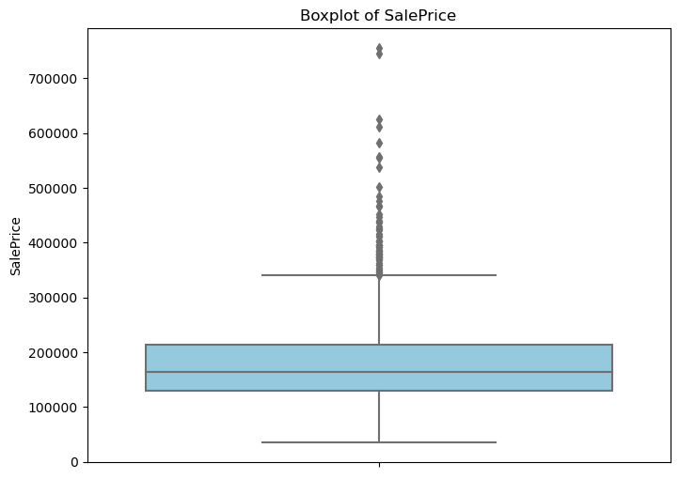
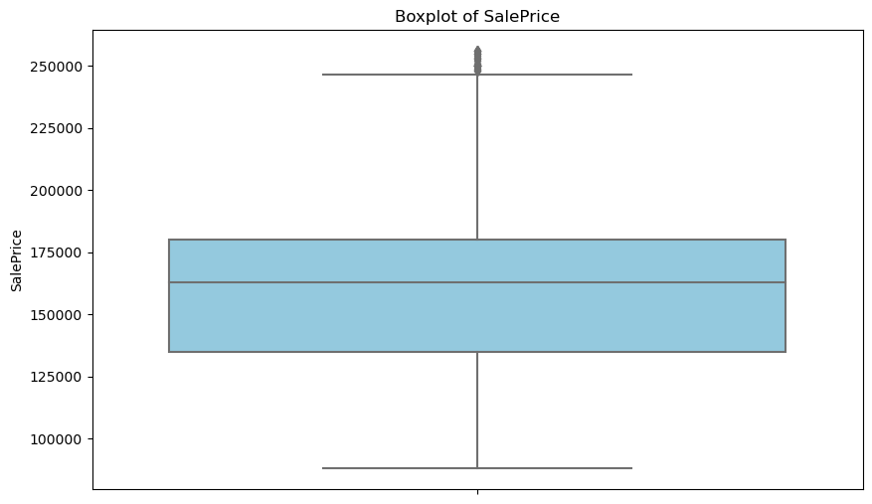

Slide 7
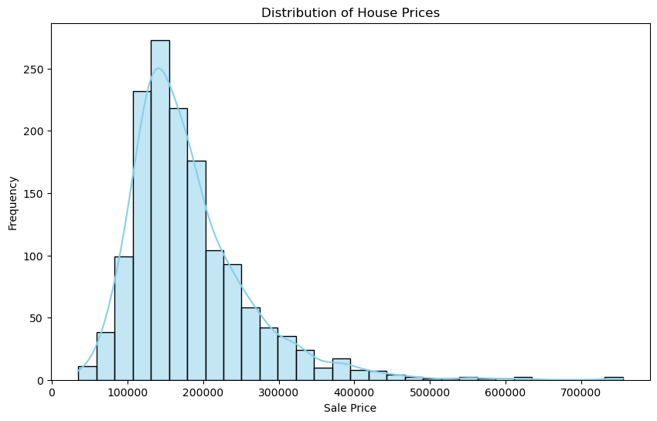
Skewness
From the histogram plot, we can observe that the distribution of house prices is slightly right-skewed, with most house prices concentrated around the lower to mid-range of the price spectrum. There are relatively fewer houses with very high sale prices, as indicated by the long right tail of the distribution.

Slide 8
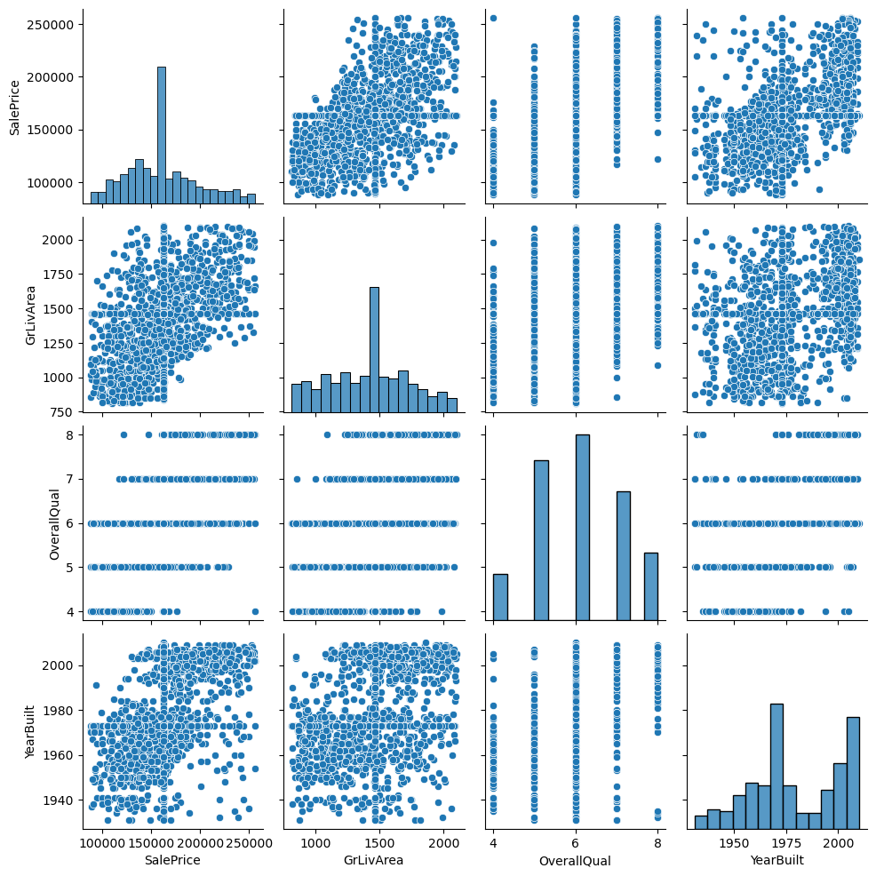
This pair plot provides a comprehensive visual summary of the relationships between numerical variables in the dataset, aiding in exploratory data analysis and identifying potential patterns or trends.

Slide 9
Feature Engineering
Feature Engineering is step in which either we create a new feature or transform existing into a new feature to enchance the performance of analysing.
# Create new features
df1['PricePerSqFt'] = df1['SalePrice'] / df1['TotalBsmtSF']
df1['PropertyAge'] = df1['YrSold'] - df1['YearBuilt']
df1['PricePerSqFt'] = df1['SalePrice'] / df1['GrLivArea']

Slide 10
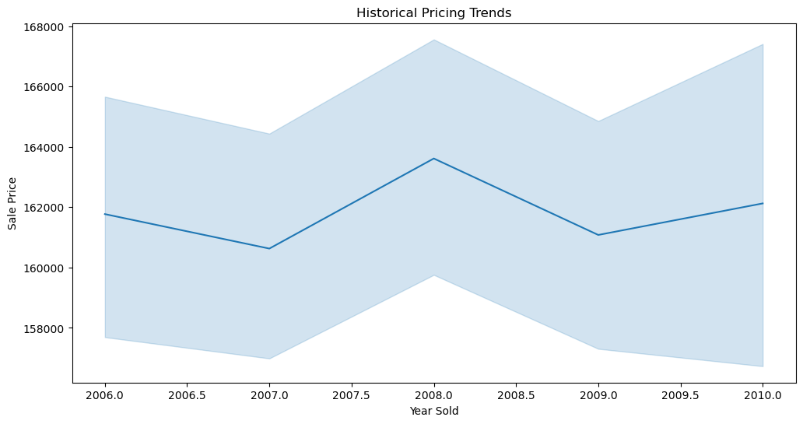
Market Trends, Customer Preference & Amenities
we can check for any significant increases or decreases in sale prices over time, identify peak years 2008, for property sales, or detect any anomalies or outliers in the data.

Slide 11
Conclusion
The dataset, comprising real estate information which evolves to house price, was cleaned by addressing missing values and ensuring data integrity.
Descriptive Statistics and visualisation was done for revealing the insight of dataset by using techniques of univariant and multivariant analysis.
Outliers were identified and treated using IQR.
Feature Engineering has performed for generating new feature and check the impact of Sale Price, year of sale, Gr living Area, and etc.
Checking the demand of amenities among customer.

Slide 12
Thank you

